Slide 1
Bioinformatics Final Deliverables
Tanish Kumar

Slide 2
Background
Run 44 samples(25 normal and 19 cancer) through a Bioinformatics analysis pipeline.
Used GSM21510 and removed LCM samples.
Original paper used DeSeq2, DAVID, and STRING, and KEGG pathways.

Slide 3
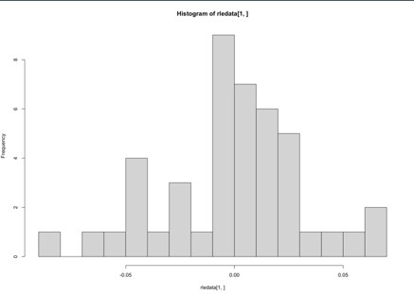
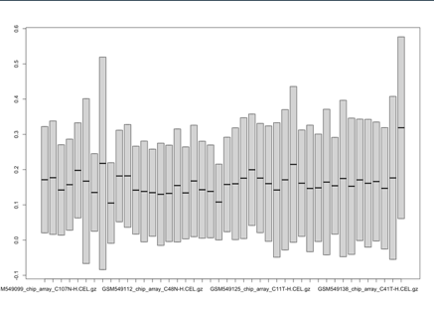
RLE Data
The histogram is centered around 0 which is a sign of good quality.
Samples 6 and 44 stick out in the box plot.

Slide 4
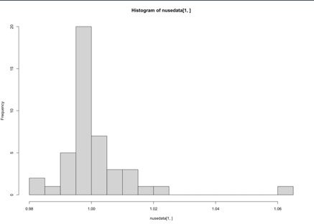
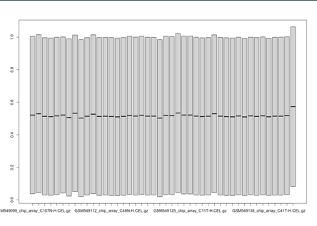
NUSE Data
The histogram is centered around 1 which is a sign of good quality.
Sample 44 sticks out slightly in the box plot.

Slide 5
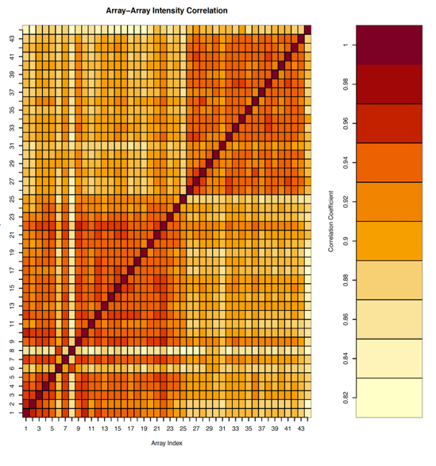
Heat Map (QCReport)
Samples 6, 8, and 44 stick out slightly in plot which is a sign of bad quality.
However, we can see relatively good clustering which is a sign of overall good quality.

Slide 6
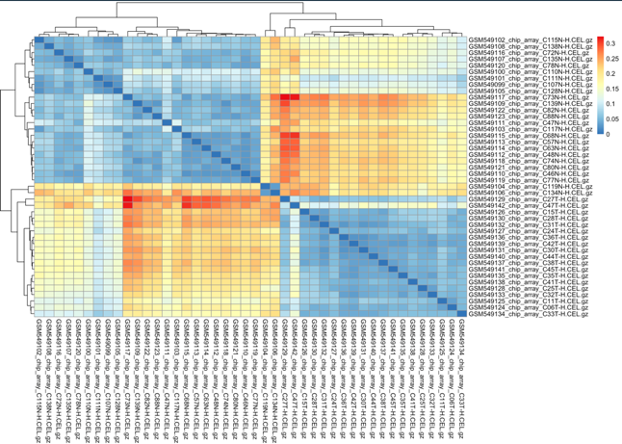
Heat Map (pheatmap)
Sample 44(GSM49142) sticks out.
We see good clustering here as well.

Slide 7
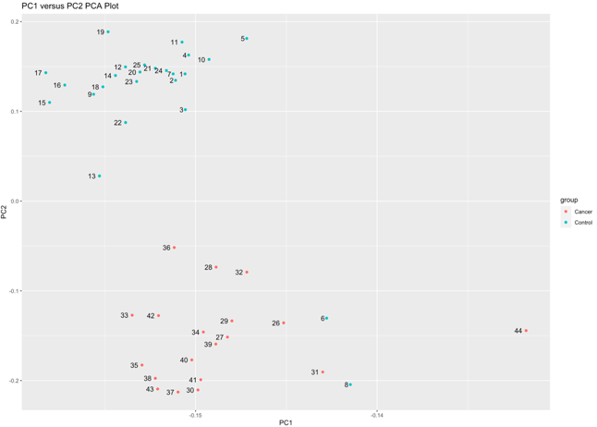
PCA Plot
Again, we see Samples 6, 8, and 44 as outliers (bad quality).
Overall, we can see a clear control group cluster and a cancer group cluster.

Slide 8
Samples 6, 8, and 44 were removed before performing further analysis.

Slide 9
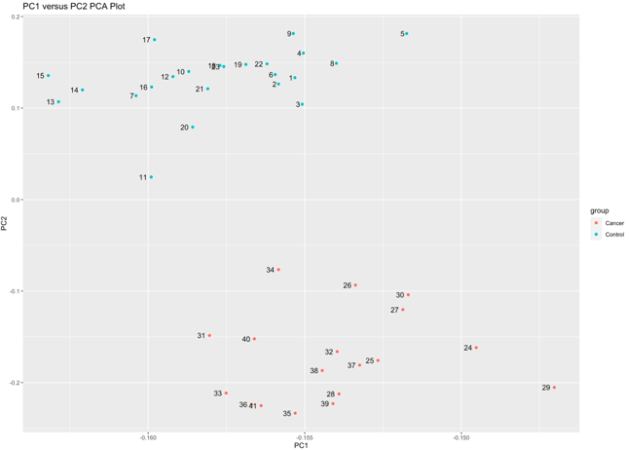
PCA Plot #2
There are arguably no outliers(possibly #11)
Very clear clustering

Slide 10
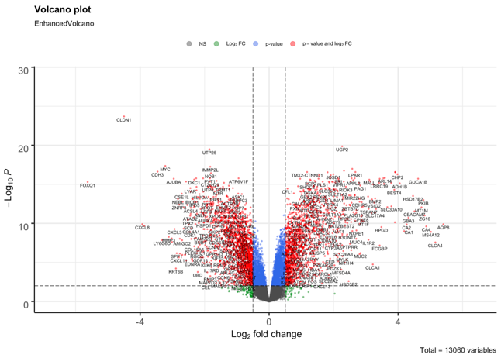
Volcano Plot
13,060 total genes plotted
Most notable genes: FOXQ1, CLDN1, CDH3, UGP2, CLCA4, etc.
3,093 total differentially expressed genes above(or below) a Log Fold Change Threshold of $±0.5$ and below a p-value cutoff of 0.01.
1,450 genes are upregulated
1,643 genes are downregulated

Slide 11
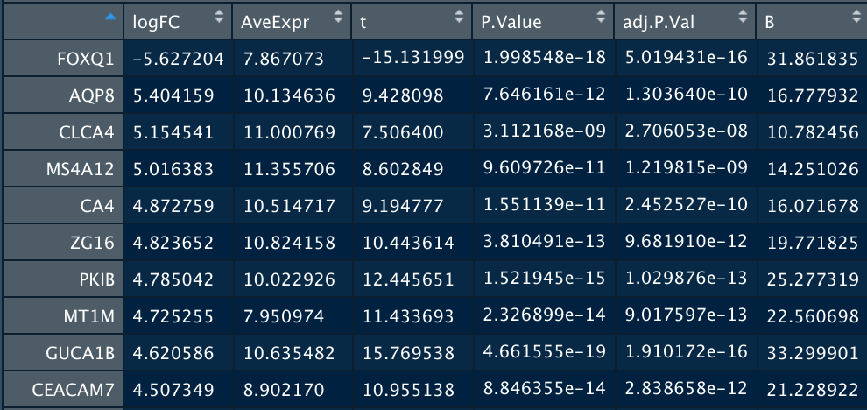
Top Ten Differentially Expressed Genes

Slide 12
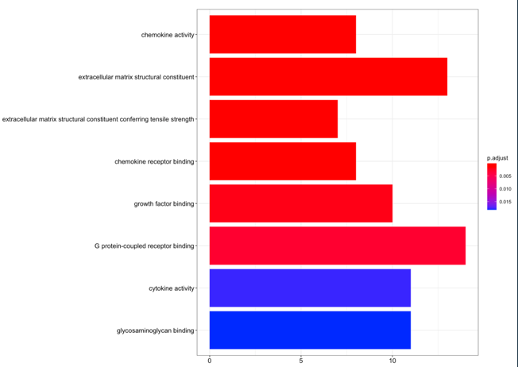
enrichGo Result

Slide 13
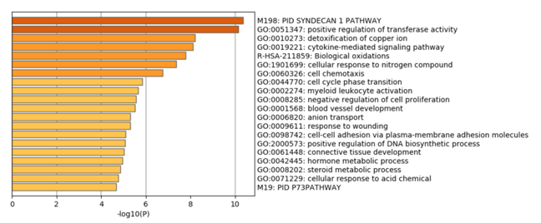
Metascape Gene Analysis Report Plot #1
PID SYNDECAN 1 PATHWAY: Deals with tumor cells involved in repairing bone tissue
Positive regulation of transferase activity: Increase in the frequency of transferase activity(transferring of functional groups between molecules)

Slide 14
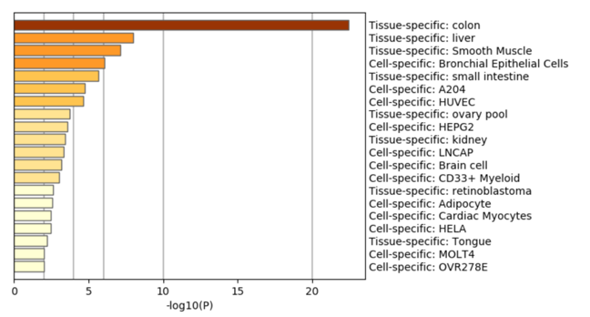
Metascape Gene Analysis Report Plot #2
Many of the genes related to the colon which is to be expected as we are comparing normal patients and patients with colorectal cancer.

Slide 15
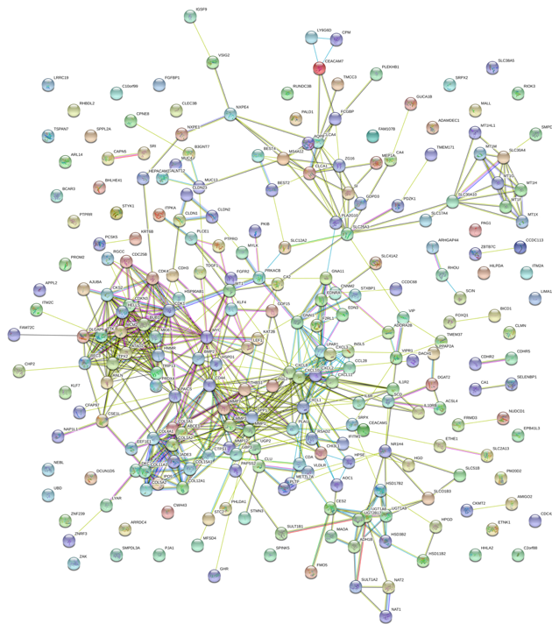
STRING PPI Network

Slide 16
Pipeline Summary
Quality Control
Finding DEGs
Functional Analysis
PPI Network
Used affyPLM, affyQCReport, and pheatmap packages
Generated RLE and NUSE plots and heatmaps.
Found Samples 6, 8, and 44 as having bad quality and removed them
Used model.matrix and EnhancedVolcano
Discovered 3,093 differentially expressed genes
Used enrichGO(), enrichKEGG(), and Metascape
259 Genes
Used STRING
Used 250 genes

Slide 17
Challenges
Initially, I was not sure whether to include the LCM samples through my pipeline.
I had to debate whether to remove the samples with bad quality.
I had trouble generating the correlation matrix for the heat map but was able to troubleshoot.
I tried using Enrichr instead of Metascape in the beginning however it did not give me the results I was looking for.

Slide 18
Things Learned
How to use Metascape
How to use affyQCReport
Generating a heatmap using a correlation matrix and pheatmap
Criteria for removing samples
How to create a pipeline

Slide 19
Achievement Highlights
I was able to run a dataset successfully through my chosen pipeline
I was able to complete all the final deliverables on time.
I was able to troubleshoot through mentors and other interns.

Slide 20
One Thing That Makes Me More Excited about Bioinformatics
Although the field of Bioinformatics is well-developed, there is still a large of amount of area left to explore!

